Slide 1

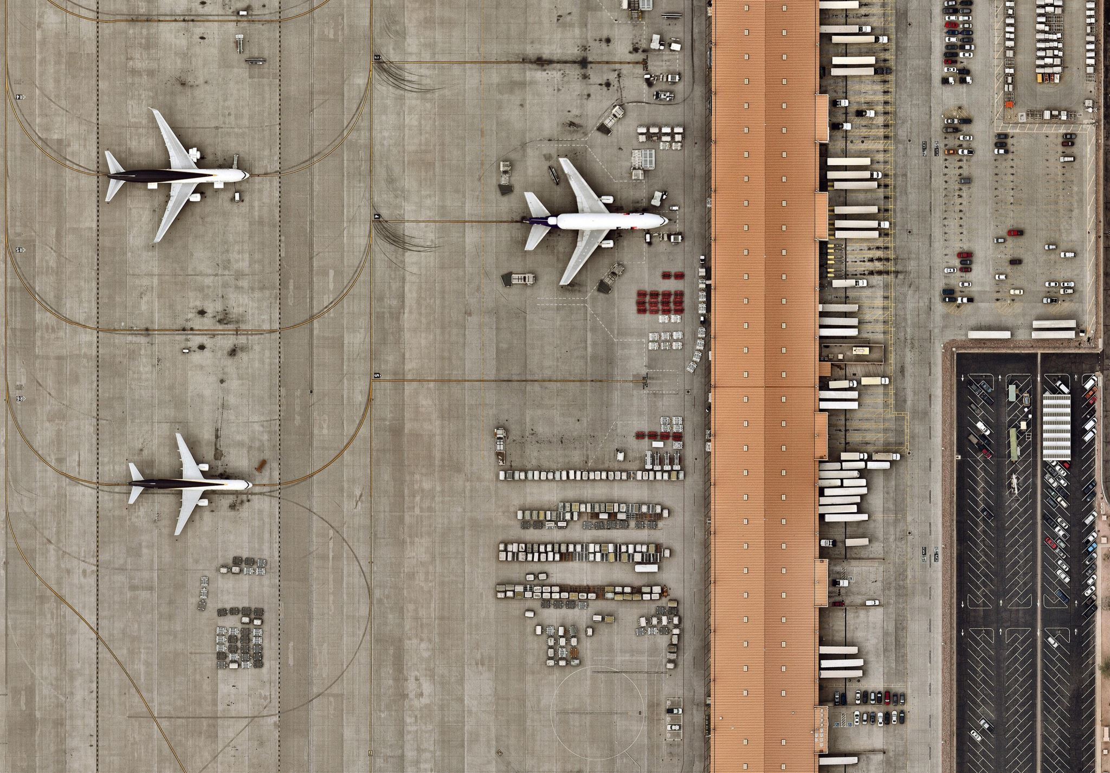
Flight Reservation System
Karim Kousa, up202102687
Saara Kovanen, up202211974
Silvia Tavares, up202204392

Slide 2

Introduction
Nowadays, businesses accumulate and store significant amount of data on a daily basis
Creates challenges in reviewing & accessing data
Immediate access to complex & timely analysis is required
Data warehousing creates centralized data storage for managing and retrieving data
Foundation for business intelligence & effective data analysis
Data warehousing plays a crucial role in the management and analysis of flight related data

Slide 3
Subject Description
The aim of this project is to design a comprehensive data warehouse for a flight reservation system
Consolidates and manages data from various sources
Kaggle.com and Openflights.org
Information on bookings, passengers, and flights from multiple airports and airlines
The data warehouse is designed to efficiently store, retrieve, and analyze large volumes of data
The data warehouse will provide a comprehensive and holistic view of the flight reservation system
The final deliverables of the project will be a well-designed and documented data warehouse architecture, ETL processes, and a dimensional data model

Slide 4
Planning Bus Matrix
Data mart | Star | Dimension | Aircraft | Airline | Airport | Date | StatisticPeriod | Flight_Class | Passenger | Schedule | Time
Travel | Flight |  | x | x | x |  |  |  |  | x
 | Booking |  |  | x | x | x |  | x | x |  | x
 | Flight Statistics |  |  | x | x |  | x

Slide 5
Planning Dictionary of Dimensions
Name | Description | SCD | Version | 1.0 | Date | 28.3.2023
Aircraft | Aircraft of a flight | type 1 | Hierarchy | Aircraft < Airline
Attribute | Description | Level | Key | Type | Size | Precision
Aircraft_id | Airline surrogate | Aircraft | PK | ID
Name | Name of an aircarft | Aircraft |  | Varchar | 50
IATA | IATA code | Airline | LK | Varchar | 10
ICAO | ICAO code | Airline |  | Varchar | 10
Name | Description | SCD | Version | 1.0 | Date | 28.3.2023
Passenger | Passenger of a flight | type 1 | Hierarchy | Passenger
Attribute | Description | Level | Key | Type | Size | Precision
Passenger_id | Passenger surrogate | Passenger | PK | ID
First_name | First name of passenger | Passenger |  | Varchar | 50
Last_name | Last name of passenger | Passenger |  | Varchar | 50
Age | Age of passenger | Passenger |  | tinyint
Gender | Gender of passenger | Passenger |  | Varchar | 1

Slide 6
Planning: Dictionary of Facts
Star | Booking | Version | 1.0 | Date | 28.3.2023
Granularity | Process of booking
Dimensions
Time_id | Time
Date_id | Date
Class_id | Flight Class
Passenger_id | Passenger
Origin_Airport_id | Airport (Origin)
Arrival_Airport_id | Airport (Destination)
Airline_id | Airline
Measures
Seat | Flight seat of a booking
N_Stops | Total number of stops in a booking
Duration_stops | Total duration of stops in a booking

Slide 7
Scope Document Company goals
Data Integration
The data warehouse should integrate data from various sources
Data Storage and Management
The data warehouse should efficiently store and manage large volumes of data
Data Analysis and Reporting
The data warehouse should support advanced analytics and reporting capabilities
The data warehouse should implement robust security measures to protect the data
Security and Data Privacy

Slide 8
Scope Document Scope of Phase 1
Duration: 3 Weeks
Data Spam: Two years (2017 – 2019)
Phase 1 is completed by 10.4.2023
Develop:
The number of flights to and from each airport
Records of delays (and locations)
Number of bookings made for an airline

Slide 9
Scope Document Exclusions from phase 1
Functionalities:
For example, customer service or airport security management have not been included in the phase due to the lack of data regarding these operational services.
Data sources:
Limits the amount and type of data they provide. For example, the different airlines don’t provide customer sensitive data due to privacy regulations.
Budget and resources:
Limit the scope of this project phase to only include certain airlines and geographies.

Slide 10
Scope Document Success criteria
Successful integration of the data
Dimensional data model built
The dimensional data model is successfully implemented in MySQL
Requirements implemented:
A: The number of flights to and from each airport
B: Records of delays and locations
F: Number of bookings made for an airline

Slide 11
Scope Document Risks and Mitigations
Data quality risks:
Poor data quality can result in incorrect or unreliable analytics, reporting, and decision-making.
Security Risks
Data security risks may involve unauthorized access to sensitive data, data breaches, or data privacy violations.
Data Integration Risks:
Data integration risks may result in delays, errors, or incomplete data in the data warehouse.

Slide 12
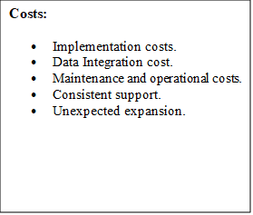
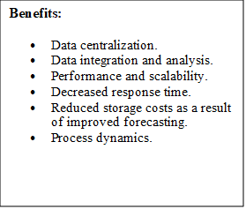
Costs & Benefits

Slide 13
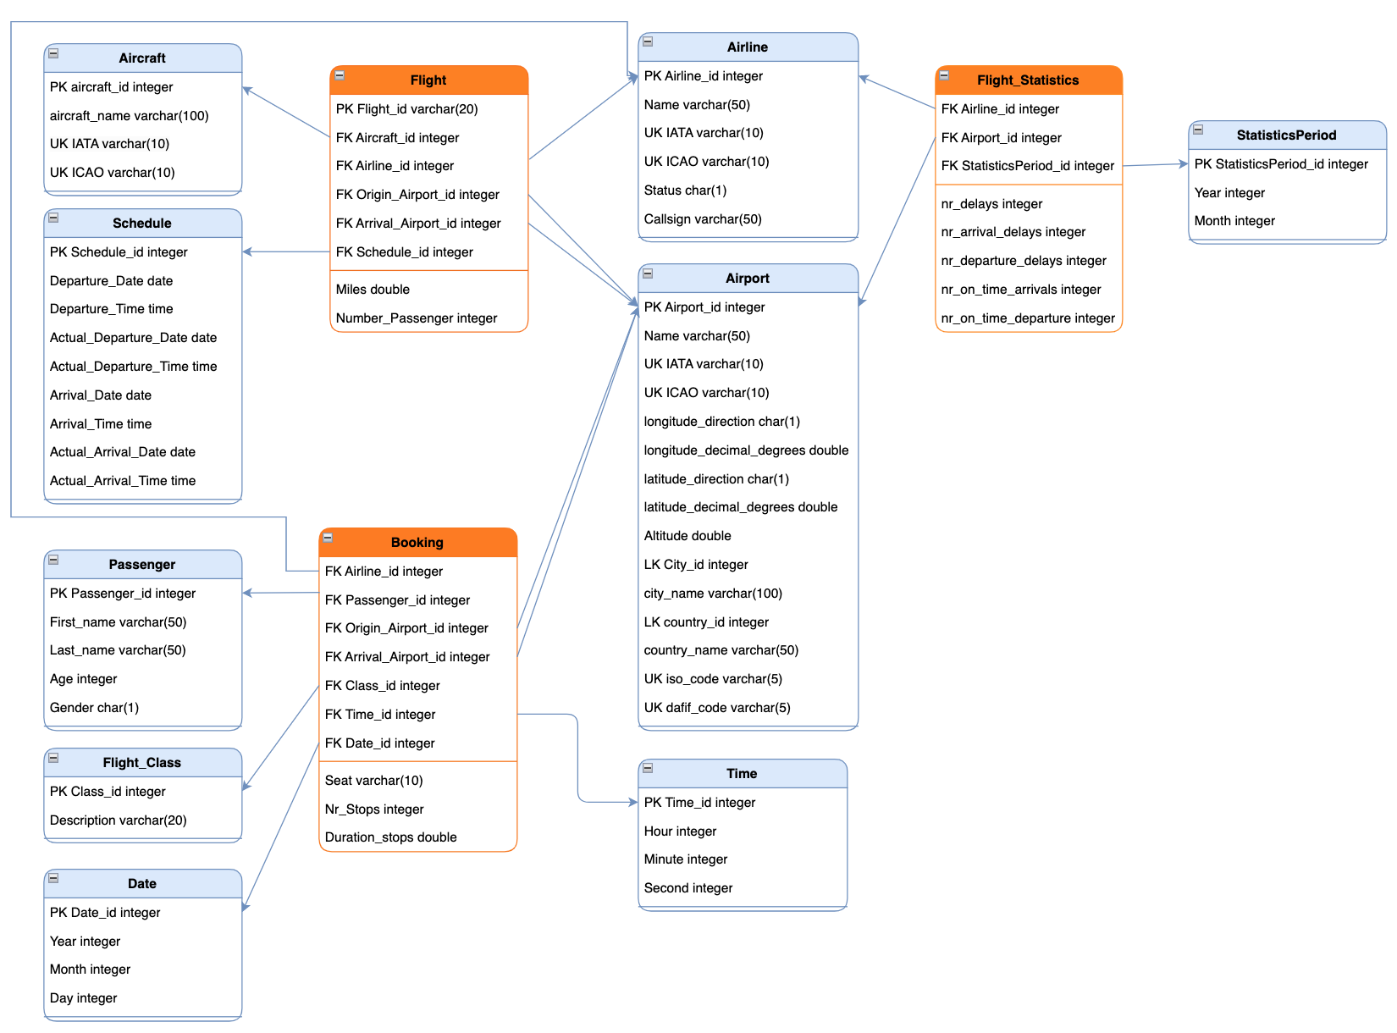
Dimensional Data model

Slide 14

EXTRACTION, TRANSFORMATION AND LOADING
The data was extracted from two different sources: Kaggle and Openflights
5 sets of Excel workbooks containing different information regarding the flight travel system.
Data transformation was implemented in Power Query
Cleaning the data, deleting unwanted rows & transforming it to a standard and unified format
Python was also used to better understand the data
Transformed data was loaded into MySQL
Table creation according to the dimensional model, joining the tables & loading the information to the tables

Slide 15
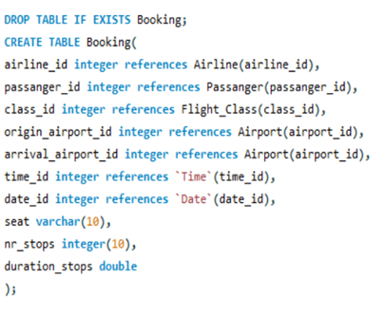
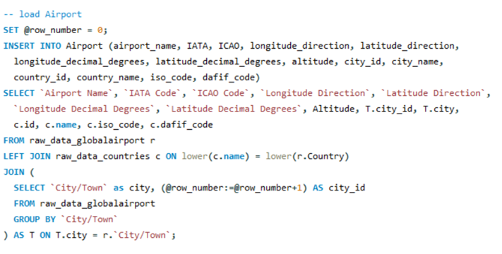
Querying Process
The source files were imported to MySQL Workbench
Tables from the dimensional model were created and populated

Slide 16
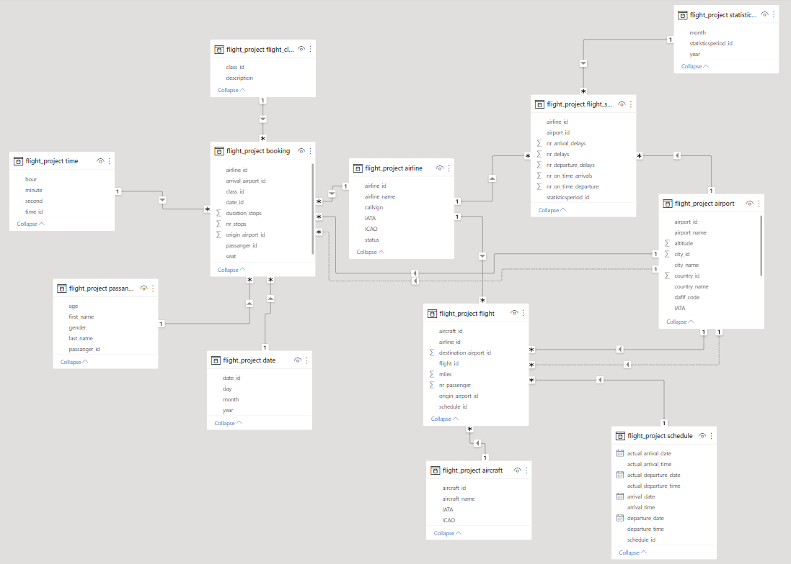
Power BI – Dimensional model

Slide 17
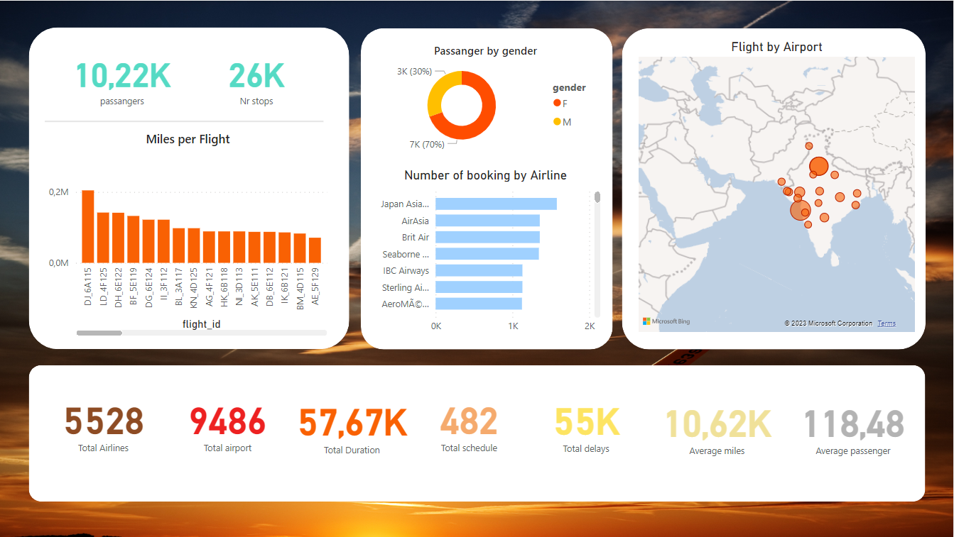
Data Analysis

Slide 18
Operational Databases: Reflection
Advantages:
Increased efficiency
Increases the efficiency by allowing agents to quickly access and modify customer information, flight schedules, and seat availability in real-time.
Improved data management
Centralized location for storing and managing customer and flight data.
Real-time data
Allows quick responses to changing conditions and minimizes disruptions to travel plans.
Better decision-making
Provides insight into customer behavior and preferences.
Shortcomings:
Data security risks
Databases can be vulnerable to data breaches, which can result in the loss or theft of sensitive customer information.
Reliance on technology
The data warehouse is reliant on technology, which can fail or experience glitches. This can result in delays or errors in the booking process.
Complexity:
It can be complex and require a significant amount of maintenance and management, which can be costly and time-consuming for airlines.
Lack of flexibility:
The operational database can sometimes be inflexible, making it difficult to make changes or adapt to new circumstances.

Slide 19
Conclusions
Organizations now have access to more information than ever
Need for a centralized storage to managing and accessing data has grown
Data warehouses provide a centralized storage for accessing and analyzing data
A data warehouse can be a valuable tool for a flight reservation system
Provides numerous benefits to airlines and their customers
Understand customer behavior, optimize flights, reduce wait times for customers, among others
Data avalability and implementation costs can be a drawback
The decision to implement a data warehouse in a flight reservation system always needs to be carefully considered depending on the case

Slide 20

Next steps
Additional information to the dimensional model
Boarding pass, boarding gate, terminal, airline capacity, bags registration...
Cabin crew management data mart
Populated with data that is relevant to the cabin crew
Provides the cabin crew department with quick and easy access to the information they need to perform their jobs effectively
Supports strategic decision-making by providing insights into passenger behavior, crew preferences, and other factors that can impact the overall performance of the airline

